Slide 1

DEPARTMENT OF COMPUTER SCIENCE AND ENGINEERING
SIKKIM MANIPAL INSTITUTE OF TECHNOLOGY
INSTRUCTIONS for
PURSING B.TECH(CSE) MAJOR PROJECT
2024 BATCH

Slide 2
PURSING B.TECH(CSE) MAJOR PROJECT
Self-Arranged Major Project(External)
Major Project arranged through T&P Cell, SMIT
Major Project in CSE, SMIT (In-house)

Slide 3
Self-Arranged Major Project(External)
Student willing to pursue major project which has been self-arranged from a company/institute/organization or any reputed university should follow the following procedures:
Candidate must seek prior permission from CSE Dept., SMIT by filling the required information at: projectwork.dalabsmit.in
Last date of sending the request form is on 31stDec’2023.
All the candidates must join their respective major project location on or before 15th Jan’2024.
On joining the respective location, all the candidates must report their joining details by filling up the form at: projectwork.dalabsmit.in

Slide 4
Self-Arranged Major Project(External) contd..
5. Internal reviewer will be allocated for each group on received of joining report.
6. Duration of the project is 16weeks clear calendar week in single organization.
7. All the project work should be related to Computer Science which should include development/testing/design.
8. A maximum of two in a group is permitted.
9.The project must not be direct or indirect supervision of relatives/family.

Slide 5
Major Project arranged through T&P Cell, SMIT
1. Date of joining will be intimated by the respective company.
2. Number of members in a group will be as per the company.
3. The project must not be in direct or indirect supervision of relatives/family.
4. On joining the respective location, all the candidates must report their joining details by filling up the form at: projectwork.dalabsmit.in

Slide 6
Major Project in CSE, SMIT (In-house)
Candidate should give at least 3-4 broad areas of interest and fill up the IN_HOUSE_REGISTRATION_2024** by 10th Jan 2024( tentatively)
Student willing to pursue major project from CSE,SMIT ,the starting date is from 10th Jan 2024 (tentatively) .
All the project is an individual project, no groupwise project is offered by the department.

Slide 7
Major Project in CSE, SMIT (In-house) contd..
4. Based on the feasibility or availability a project guide will be allocated.
5. Candidate will be encouraged to choose problems which have publication and patent potential.
6. Separate instructions will be circulated

Slide 8
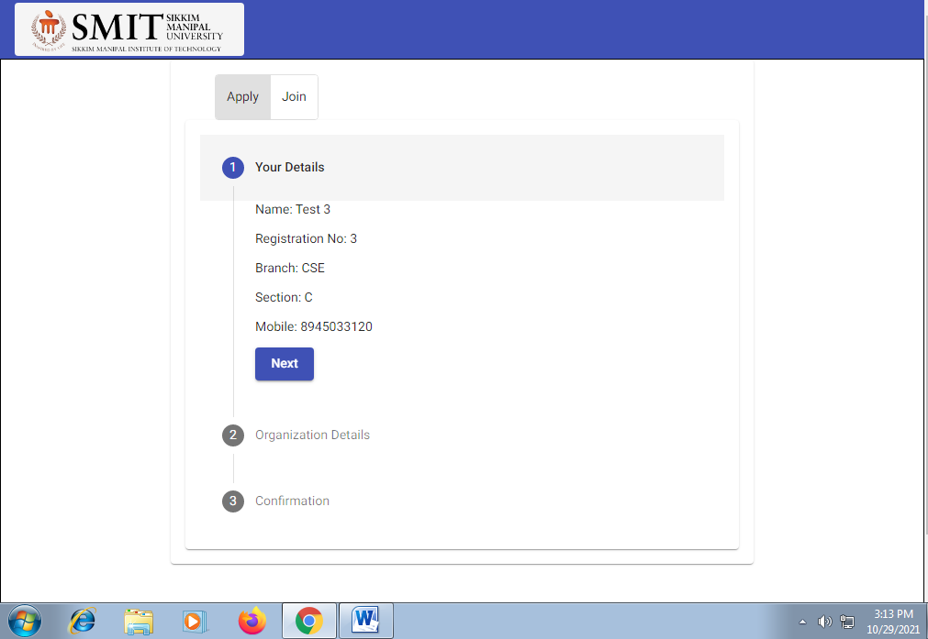
How to apply for NOC to Join one Self Arranged organization for Major project

Slide 9
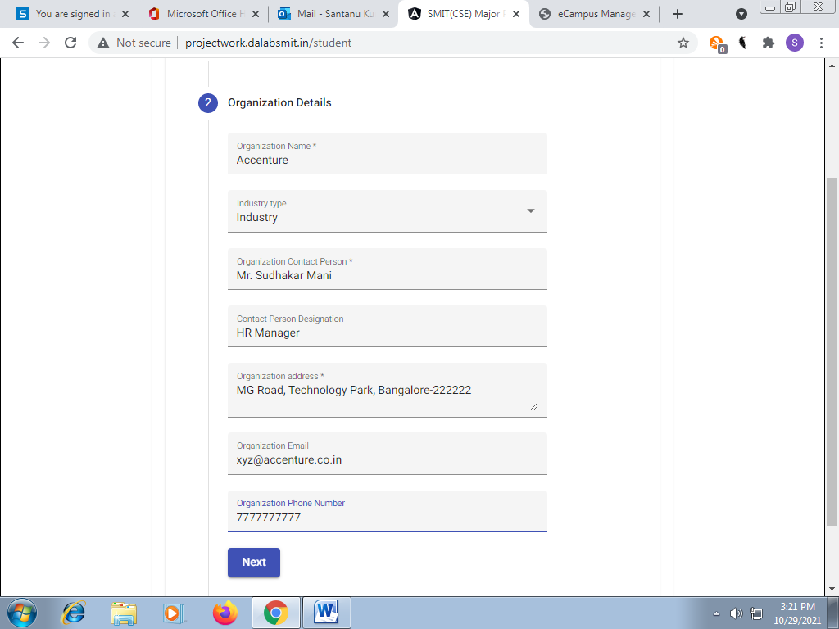

Slide 10
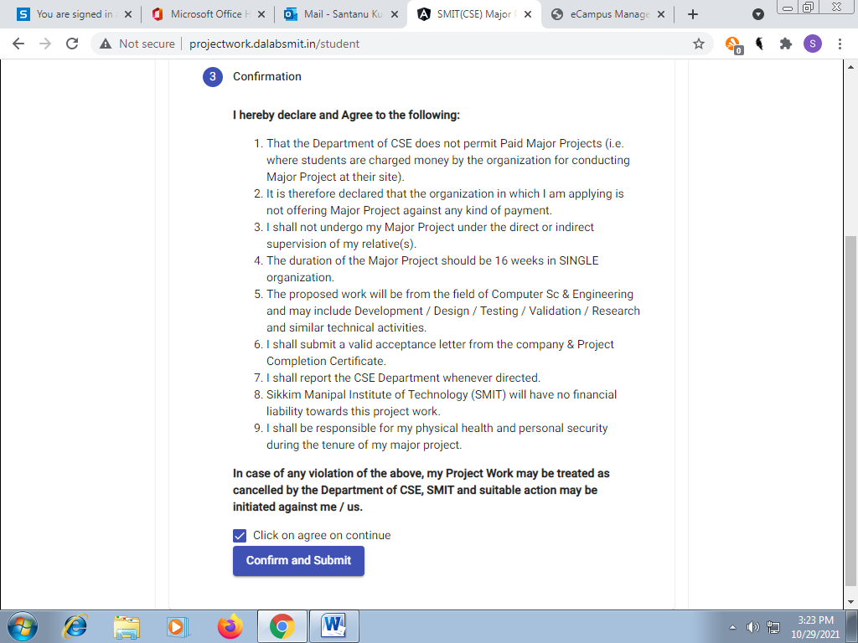

Slide 11
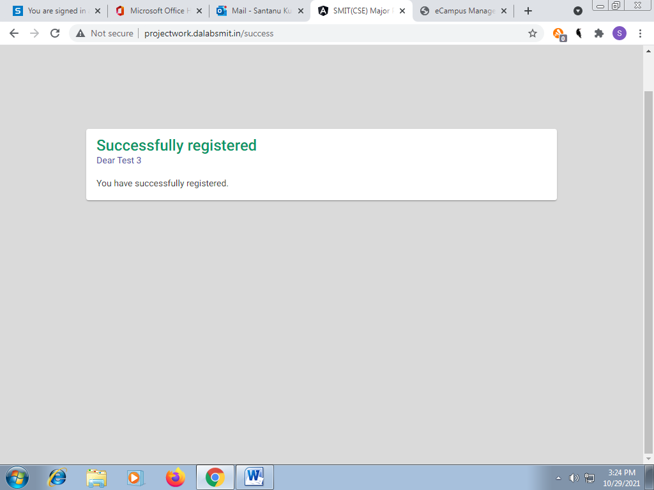
Request for NOC has been sent to CSE dept,SMIT

Slide 12
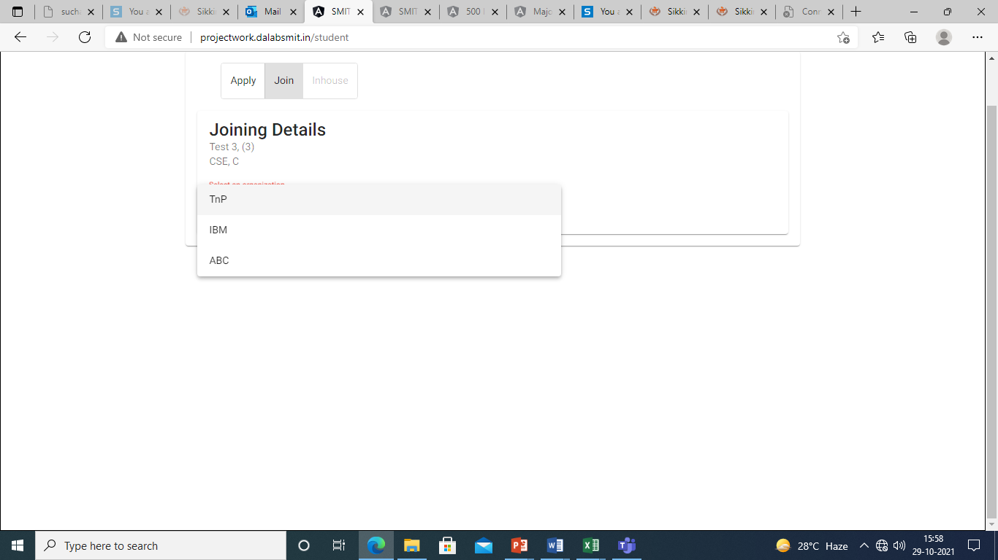
For sending Joining Report

Slide 13
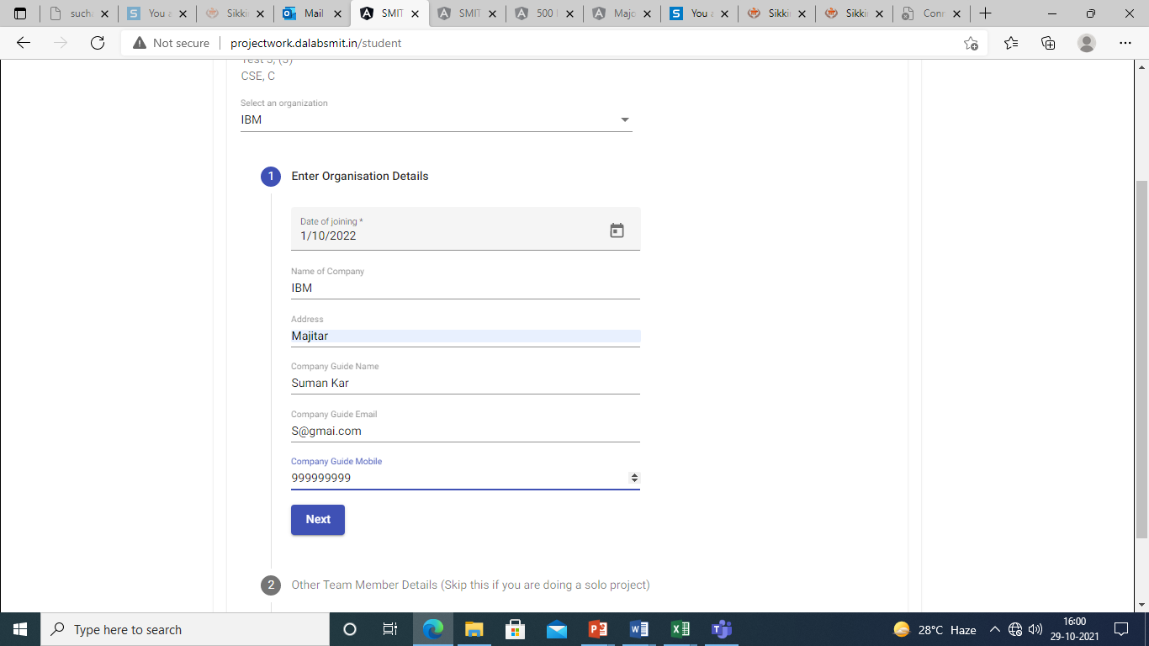
Details of your Organization

Slide 14
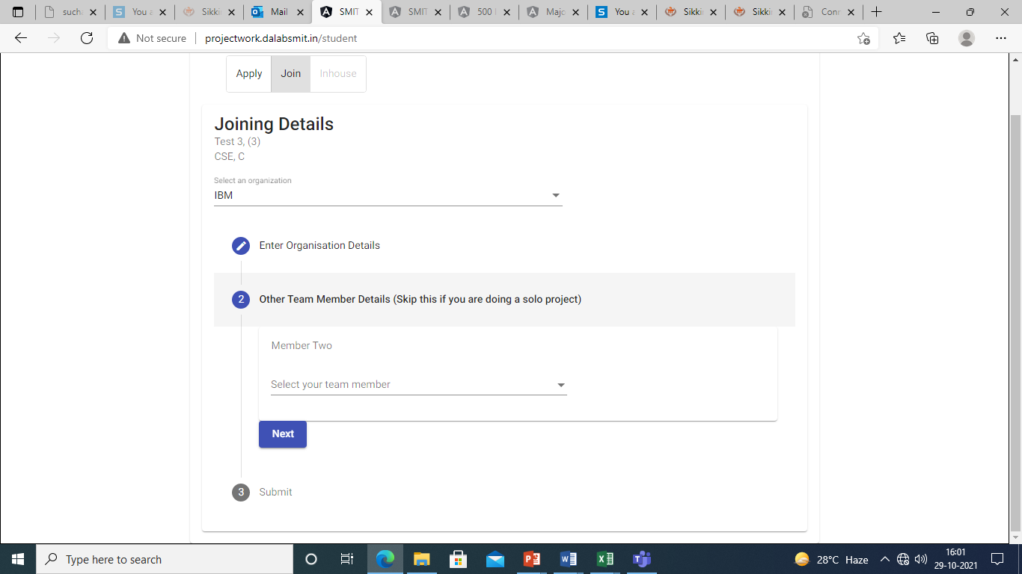
If another students is working with you in the group(need to present together)

Slide 15
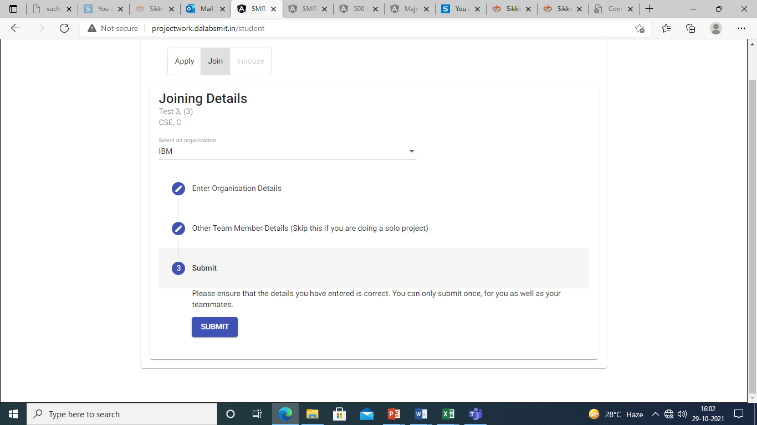
Last step of sending Joining report

Slide 16
Major Project Progress Evaluation
Sl No | Type of Evaluation
1 | Synopsis Presentation
2 | Guide Initiated 1
3. | Progress Presentation 1
4. | Guide Initiated 2
5. | Progress Presentation 2
6. | Internal Presentation
7. | External Presentation

Slide 17
TO NOTE:
All the seminar will be evaluated based on the PPT presentation, report and Viva.
Project Demonstration in the form of Working Model / Live Software demonstration may be required to be showcased.
In-house projects will mandatorily be demonstrated.
One copy of the report(soft copy) duly verified by respective supervisor should be submitted to the major project coordinator for future assessment.
In case of absent in the seminar, shall not be considered further without any proper approval from supervisor and HOD, CSE.

Slide 18
TO NOTE contd:
External Candidate must submit the following details:
Project Completion Certificate on completion of 16 weeks project work.
Performance Marks to be mailed by your External guide to your Internal reviewer over an email using their organization domain.
Failing to submit anyone of the above two shall not be allowed to give their internal presentation.

Slide 19
Contact Details:
Major Project(B.Tech, CSE) Co-ordinator :
Sl No | Name | Contact Number | Email ID
1 | Santanu Kumar Mishra | 8927257899 | santanu.m@smit.smu.edu.in
Major Project(B.Tech, CSE) members:
Sl No | Name | Contact Number | Email ID
1. | Nilesh Kumar | 7909045025 | nilesh.k@smit.smu.edu.in
2. | Sourav Paul | 9748445834 | sourav.p@smit.smu.edu.in
3. | Chitrapriya N. | 7679242505 | chitrapriya.n@smit.smu.edu.in
All documents and query related mailing address: cse.s@smit.smu.edu.in

